Slide 1
Automatic vehicle alert system using ibm cloud
By Team Gryffindor

Slide 2
Our Project Aims at:
Using Iot as a platform to store real time data
Making an alert system
Sending the location of the accident to the nearby rescue systems

Slide 3
Hardware components:
Arduino
Node MCU
GPS Module- NEO-6m
Accelerometer- ADXL-335

Slide 4
Software Components:
Arduino IDE
IBM Cloud
msg91

Slide 5
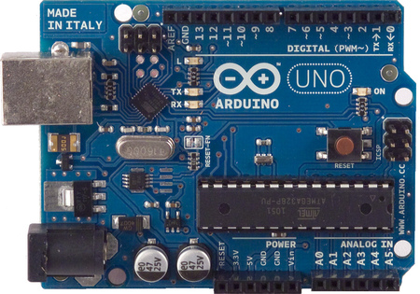
Arduino UNO:
The Arduino Uno is a microcontroller board based on the ATmega328 .
It has14 digital input/output pins (of which 6 can be used as PWM outputs), 6 analog inputs, a 16 MHz crystal oscillator, a USB connection, a power jack, an ICSP header, and a reset button.
It contains everything needed to support the
microcontroller; simply connect it to a computer with a USB cable or power it with a AC-to-DC
adapter or battery to get started.
The Uno differs from all preceding boards in that it does not use the FTDI USB-to-serial driver chip.
Instead, it features the Atmega16U2 (Atmega8U2 up to version R2)programmed as a USB-to-serial converter.

Slide 6
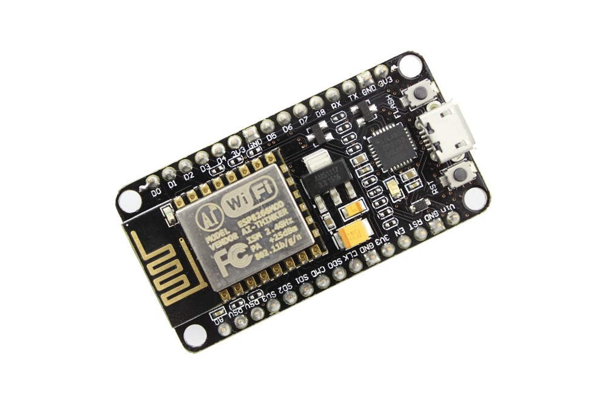
Node MCU:
NodeMCU is an open source LUA based firmware developed for ESP8266 Wi-Fi chip.
By exploring functionality with ESP8266 chip, NodeMCU firmware comes with ESP8266 Development board/kit i.e. NodeMCU Development board.
Since NodeMCU is open source platform, their hardware design is open for edit/modify/build.
NodeMCU Dev Kit/board consist of ESP8266 Wi-Fi enabled chip.
The ESP8266 is a low-cost Wi-Fi chip developed by Espressif Systems with TCP/IP protocol.
NodeMCU Dev Kit has Arduino like Analog (i.e. A0) and Digital (D0-D8) pins on its board.
It supports serial communication protocols i.e. UART, SPI, I2C etc.

Slide 7
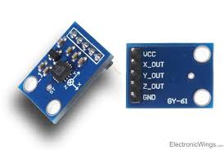
Accelerometer ADXL-335
An accelerometer is an electromechanical device that will measure acceleration force. It shows acceleration, only due to cause of gravity i.e. g force. It measures acceleration in g unit.
Accelerometer can be used for tilt-sensing applications as well as dynamic acceleration resulting from motion, shock, or vibration.
VCC: Power supply pin i.e. connect 5V here.
X_OUT: X axis analog output.
Y_OUT: Y axis analog output.
Z_OUT: Z axis analog output.
GND: Ground pin i.e. connect ground here.
ADXL335 accelerometer provides analog voltage at the output X, Y, Z pins; which is proportional to the acceleration in respective directions i.e. X, Y, Z.

Slide 8
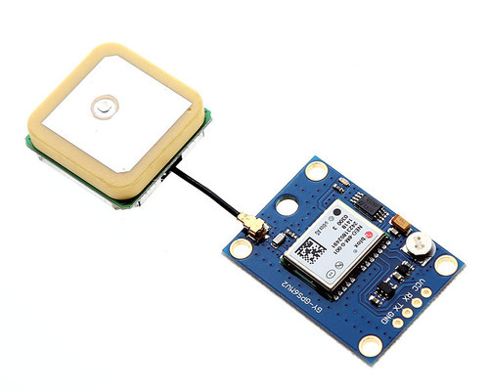
NEO-6m GPS Module
GPS module is used to read the values geographical location, accuracy of this sensor is quite good.

Slide 9
Block Diagram:
Accelerometer
Arduino Uno
MSG91
Serial Communication
NODE MCU
GPS Module
Cloud

Slide 10
Working:
In this project we are using Node MCU, Arduino UNO, Accelerometer, GPS module to store the location of the vehicle and to send the immediate alert message to the nearby hospitals, police stations…etc. Here we use serial communication to send the information from Arduino to Node MCU.
The Arduino receives the latitude and longitude values of the vehicle from the gps module. The accelerometer reads the xyz axis values. These values are read by Arduino. The xyz values are compared with the condition given in the code to check whether the vehicle is met with an accident or not.
If the vehicle is met with an accident, latitude and longitude values are copied to the NodeMCU and message is sent to the nearby police stations, hospitals using msg91 application. The gps location of the vehicle is continuously stored in the IBM cloud.

Slide 11
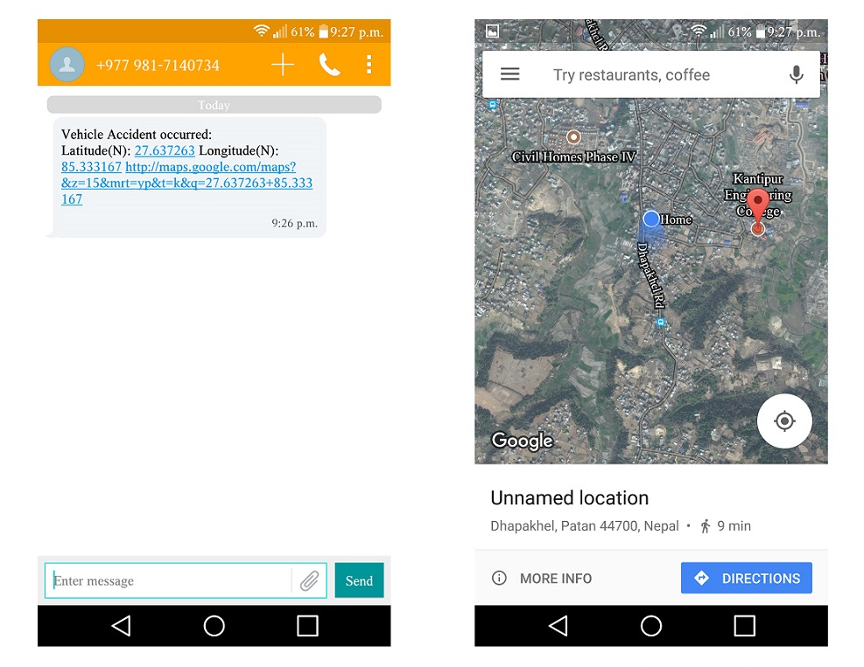

Slide 12



